Slide 1

Lecture #14

Slide 2
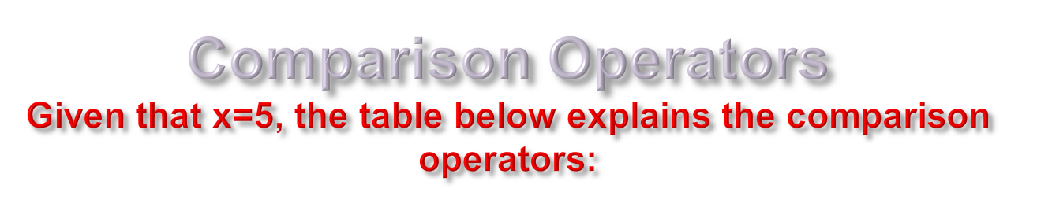
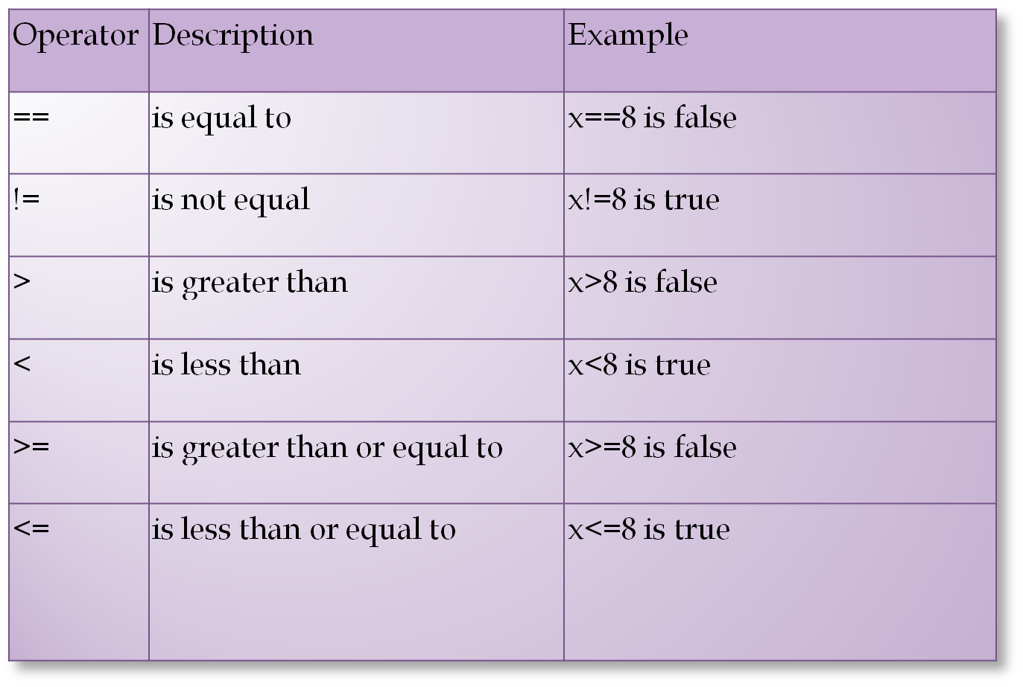

Slide 3
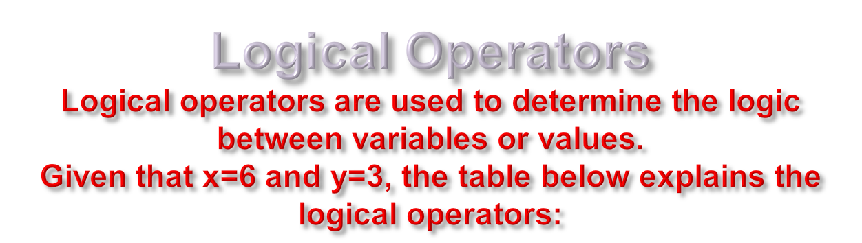
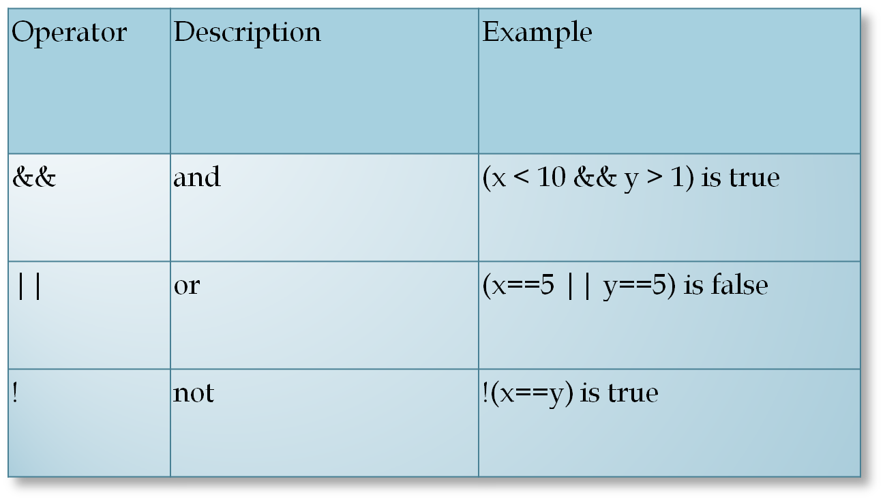

Slide 4
Conditional statements are used to perform different actions based on different conditions.
Some times you want to perform different actions for different decisions. you will use conditional statements that allow your program to make decisions.
In JavaScript we have the following conditional statements:
  if statement
  if...else statement
  if...else if....else statement

Slide 5

Use the if statement to execute some code only if a specified condition is true.
Syntax:
if (condition)
{
the code to be executed
}

Slide 6
<script type="text/javascript">
var myNum = 7;
if(myNum == 7)
{
document.write("Lucky 7!");
}
</script>

Slide 7

We already taught you how to execute code if a given condition is True, but what if you want to execute another piece of code if something is False? The answer is to use an extension to the If Statement; the Else clause.
if (condition)
{
the code to be executed
}
Else
{
the code to be executed
}

Slide 8
<script type="text/javascript">
var myNum = 10;
if(myNum == 7)
{
document.write("Lucky 7!");
}
Else
{
document.write("You're not very lucky today...");
}
</script>

Slide 9


Use the if....else if...else statement to select one of several blocks of code to be executed.
Syntax:
if (condition1)
{
code to be executed if condition1 is true
}
else if (condition2)
{
code to be executed if condition2 is true
}
else
{
code to be executed if condition1 and condition2 are not true
}

Slide 10
if (number > 0)
{
alert("Number is a positive integer");
}
else if (number < 0)
{
alert("Number is a negative integer");
}
else
{
alert("Number is 0");
}

Slide 11

You must have a normal If Statement before you can use the Else If statement. This is because the Else If statement is an addon to the If Statement.
You can have multiple Else If add-ons.

Slide 12

if (number > 4)
{
statements...
}
The above condition checks is variable number is greater than 4.

Slide 13
To check if this variable value lies between 10 and 4, we employ the && operator.
if (number >4 && number < 10)
{
statements...
}
Thus, the statements inside the if block will be executed if number equals 5, 6, 7, 8 or 9.

Slide 14
Now, if we want to display an alert box if the value of number variable is less than 20 or more than 50, we use the || operator.
if (number < 20 || number > 50)
{
alert("...");
}

Slide 15

Use the switch statement to select one of many blocks of code to be executed.
Syntax:
switch(n)
{
case 1:
execute code block 1
break;
case 2:
execute code block 2
break;
default:
code to be executed if n is different from case 1 and 2
}

Slide 16
Use switch statement when you have multiple choice and all the choices are checked for the equality condition.

Slide 17

Write a script that takes an integer from the user and checks whether the number is even or odd.

Slide 18

Write a script that takes student grade from the user and tell the student’s division.
  Grade “A” →first division
  Grade “B” →second division
  Grade “C” →third division
  Otherwise fail.

Slide 19

If(condition)
{
If(coindition)
{
statement
}
else
{
statement
}
}
else
{
statement
}
if inside the if is
called nesting of if statements.

